Slide 1
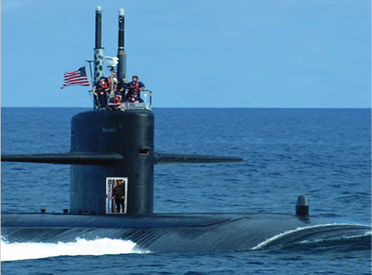
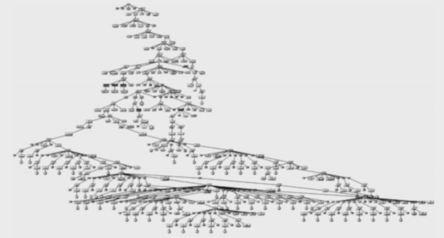





Assured Software: A Journey and Discussion
(Delivering Trustworthy Systems with Assurance)
Robert A. Martin
Sr. Secure Software & Technology Prin. Eng.
Trust & Assurance Cyber Technologies Dept.
Cyber Solutions Technical Center
AdaCore TECH DAYS BOSTON
November 14, 2018
Boston Marriott – Burlington, MA
© 2018 The MITRE Corporation. All rights reserved. Approved for Public Release; Distribution Unlimited. Case No: 18-1804-23

Slide 2

Everything is Becoming Software-Enabled and Connected, Either through Task Dependency, Supply Chain, or Information Flow
Today Your System is:
attackable or
susceptible to a hazard…
We need to be assured that not only are our own systems trustworthy but also everything we depend upon…
When this Other System
gets subverted through:
an un-patched vulnerability;
a mis-configuration;
an application weakness;
a counterfeit item;
tainted software or hardware; or
the system’s susceptibility to a hazard…
© 2018 The MITRE Corporation. All rights reserved. Approved for Public Release; Distribution Unlimited. Case No: 18-1804-23

Slide 3
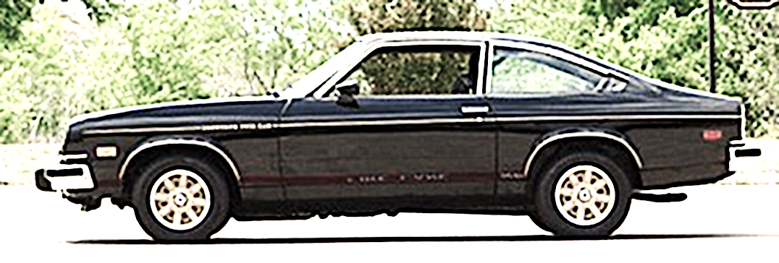
How is Software-Enabled and Connected (aka Cyber) Becoming so Pervasive?
Context: 1976 Chevy Vega
The only software was behind the wheel – no microelectronics.

Slide 4
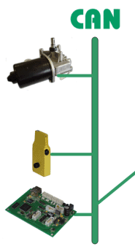
Critical Functions Migrated into Software & Microelectronics (SW/HW)
Electric throttle
valve control

Slide 5
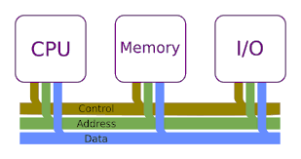
Control/Communication Transitioned from Point-to-Point Wiring to Network-based
Air
Con-dition
Engine Control
Anti- Lock Brakes
Lighting
Power Locks
Dash-board
Airbag
Power Seats
Air
Con-dition
Trans-mission Control
Active Suspen-sion
Engine
Control
Anti- Lock Brakes
Power Win-dows
Lighting
Power Locks
CAN
CAN
CAN
CAN
Connected Software and HW (microelectronics)
Dash-board
CAN
High Speed
Low Speed
CAN
CAN
CAN
CAN
Airbag
CAN
CAN
Power Seats
Trans-mission Control
Active Suspen-sion
CAN
Power Win-dows

Slide 6
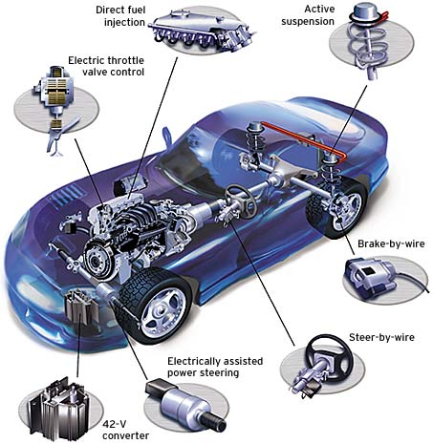
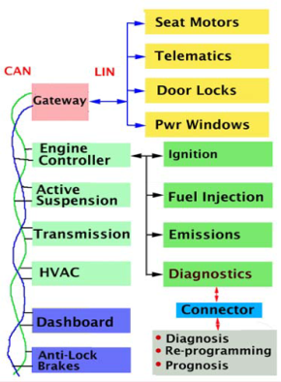



Critical Functions Are Migrating into Connected SW/HW
Anti-Lock Brakes
Transmission Control
Lighting
Air Conditioning
Power Locks
Airbag
Power Seats
Power Windows
Smart
Catalytic Converter
Beam Shaping Headlights
Beam Splitting Headlights

Slide 7
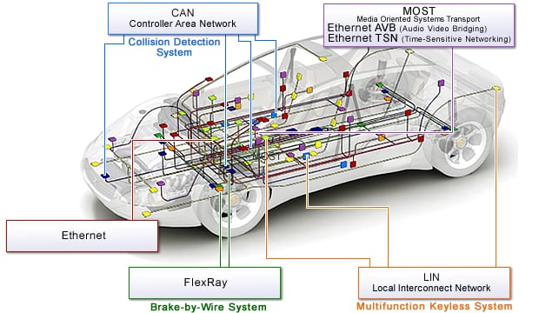
Multiple Types of Networks Are Appearing

Slide 8
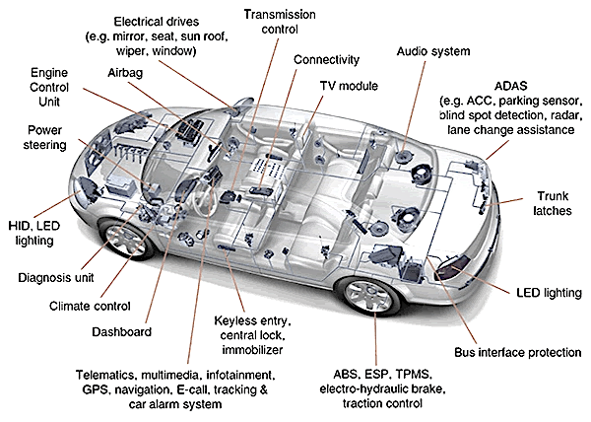
Many Critical Functions Now Need to be Updated and Sustained…

Slide 9
The Connectivity and Complexity of Connected Software-Enabled Systems is Still Expanding
Driverless Cars, ADAS, V2V, V2I, Safety

Slide 10



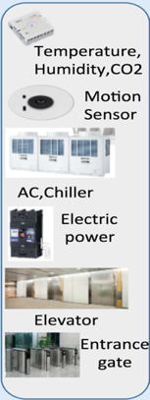
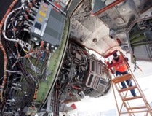

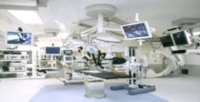
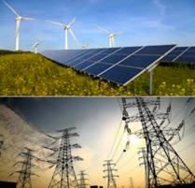

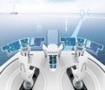

All types of Enterprises are Facing these Same Changes…
Medical
Buildings
Aeronautics
Manufacturing
Energy
Shipping
Vehicles

Slide 11
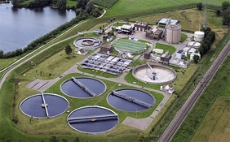
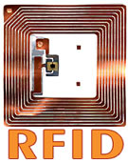
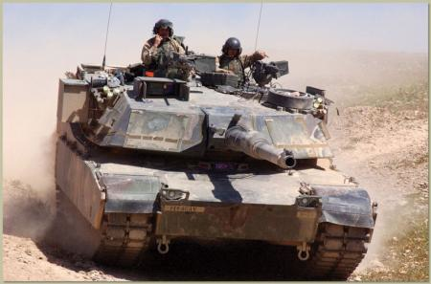
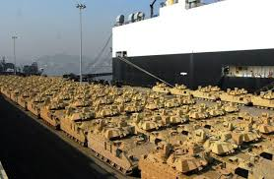


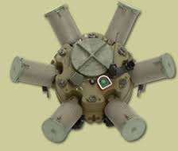
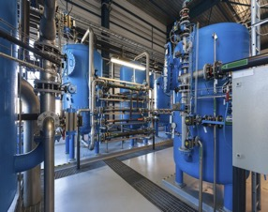
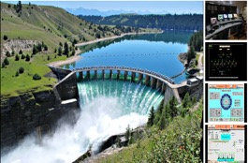

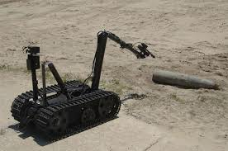
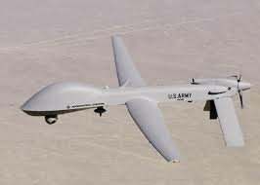
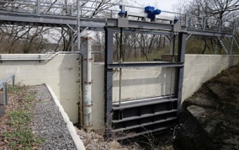
These Changes Go Well beyond Traditional Information Technology…
Water Treatment
Status & Health Monitoring
Oil & Gas
Hydro Power & Dam Mngt
Smart Munitions
Remote Management

Slide 12
Need Secure, Safe, Reliable, and Resilient Behavior that Upholds Privacy Expectations
© 2017 Gartner. All rights reserved.

Slide 13
Secure Behavior
Reliable Behavior
QUALITY GAPS
QUALITY GAPS
QUALITY GAPS
RISKS
RISKS
RISKS
RISKS
MIND THE GAP
Safe Behavior
Resilient Behavior
Privacy Expectations

Slide 14
Secure Behavior
Reliable Behavior
Weaknesses* in the software implementing capabilities; AND
Weaknesses* in the software that is implementing mission function that have quality implications when encountered
Safe Behavior
Resilient Behavior
Privacy Expectations
* Weakness can be in the software’s architecture,
design, code, and configuration/setup

Slide 15
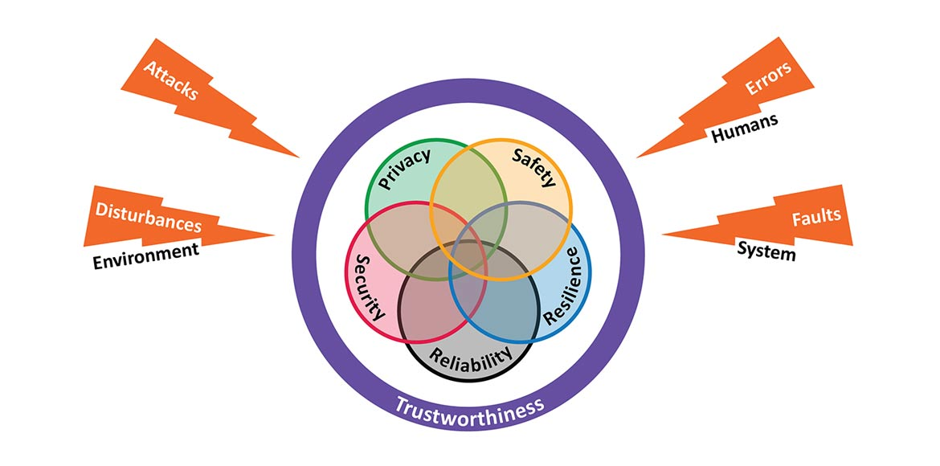

We Need Assurance of More Than Security –
Need Assured Trustworthy Systems

Slide 16
Trustworthiness as a Quality Measure
Industrial IoT Quality is a continuum of system characteristics
  OT Security (IEC 62443*) meets IT Security (ISO 27000*)
  Privacy (GDPR*), Resilience (ISO*, IEC*), Reliability (NIS*) are quality features in both OT and IT
  Determine and ensure quality measures per vertical, e.g. audit, certification
Trustworthiness Measure
Implementation
Viewpoint
Resilience
Reliability
Security
Privacy
Safety
* Examples
Interaction and relations

Slide 17
Exploitable Weaknesses, Vulnerabilities & Exposures
Weakness: mistake or flaw condition in ICT architecture, design, code, or process that, if left unaddressed, could under the proper conditions contribute to a cyber-enabled capability being vulnerable to exploitation; represents potential source vectors for zero-day exploits -- Common Weakness Enumeration (CWE) https://cwe.mitre.org/
Vulnerability: mistake in software that can be directly used by a hacker to gain access to a system or network; Exposure: configuration issue of a mistake in logic that allows unauthorized access or exploitation – Common Vulnerability and Exposure (CVE) https://cve.mitre.org/
Exploit: take advantage of a weakness (or multiple weaknesses) to achieve a negative technical impact -- attack approaches from the set of known exploits are used in the Common Attack Pattern Enumeration and Classification (CAPEC) https://capec.mitre.org
2005
WEAKNESSES
2012
VULNERABILITIES
1999
Unreported or undiscovered Vulnerabilities
CVEs
(reported, publicly known vulnerabilities and exposures)
Uncharacterized Weaknesses
Zero-Day Vulnerabilities
(previously unmitigated weaknesses that are exploited with little or no warning)
CWEs
(characterized, discoverable, possibly exploitable weaknesses with mitigations)
2002
2005
The existence (even if only theoretical) of an exploit designed to take advantage of a weakness (or multiple weaknesses) and achieve a negative technical impact is what makes a weakness a vulnerability.

Slide 18
Common Vulnerabilities and Exposures

Slide 19

Vulnerability Information Sharing (circa 1998-1999)
Alerts & Advisories
?
?
?
?
?
?
?
?
?
?
Vendor Patches
?
?
Priority Lists
?
?
?
?
?
?
?
?
?
?
?
?
?
?
?
?
?
?
?
?
?
?
?
?
?
?
?
?
?
?
?
?
?
?
?
?
?
?
Scanning Tools
?
?
Intrusion Detection Systems
?
?
?
?
?
?
?
?
?
?
?
?
?
?
?
?
?
?
?
?
?
?
?
?
?
?
?
?
?
?
?
?
?
?
?
?
?
?
?
?
?
?
Incident Response & Reporting
?
?
?
?
?
?
?
?
?
?
?
?
?
?
?
?
?
Research
Web Sites

Slide 20
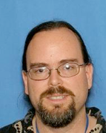

CVE Began with a Challenge for 2 of MITRE’s Technical Staff…
(Vulnerability Management: Circa 1998-1999)
How to pick a network vulnerability scanning tool?
  Which one finds more?
Are we safe against vulnerabilities listed in CERT advisories?
  How to match CERT advisory names of vulnerabilities with network vulnerability scanning tool findings?

Slide 21
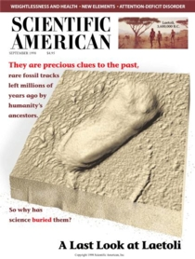
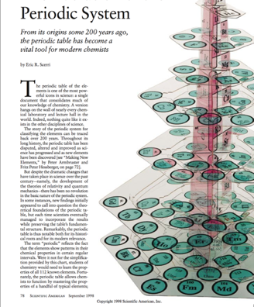
Aha moment on an Exercise Bike in MITRE’s Bedford Fitness Center in 1998…
September 1998 Issue of Scientific American article on the Periodic System:
List of Elements predated the Period Table by 100’s of Years

Slide 22
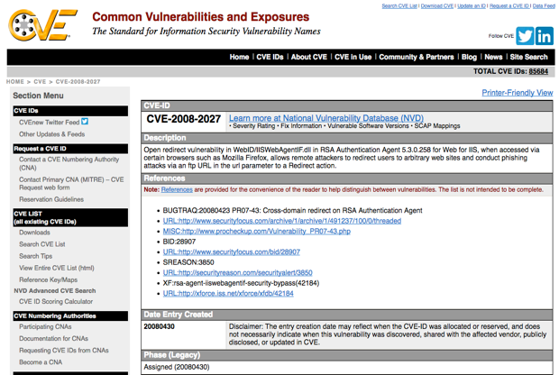
CVE Entries: Dictionary, not a Database
1) Flat Identifier
2) Short Description
3) External
References

Slide 23

Vulnerability Information Sharing (circa 1999+)
Alerts & Advisories
Vendor Patches
Priority Lists
Scanning Tools
Intrusion Detection Systems
List
Incident Response & Reporting
Research
Web Sites

Slide 24
Common Weakness Enumeration

Slide 25

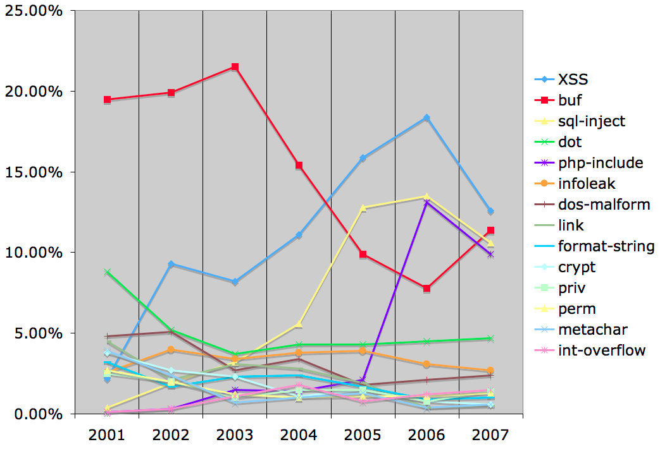
Vulnerability Type Trends:
A Look at the CVE List (2001 - 2007)

Slide 26
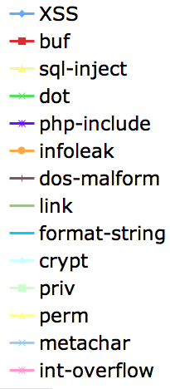

Removing and Preventing the Vulnerabilities Requires More Specific Definitions…CWEs
9
14
19
Improper Neutralization of Input During Web Page Generation ('Cross-site Scripting’) (79)
  Improper Neutralization of Script-Related HTML Tags in a Web Page (Basic XSS) (80)
  Improper Neutralization of Script in an Error Message Web Page (81)
  Improper Neutralization of Script in Attributes of IMG Tags in a Web Page (82)
  Improper Neutralization of Script in Attributes in a Web Page (83)
  Improper Neutralization of Encoded URI Schemes in a Web Page (84)
  Doubled Character XSS Manipulations (85)
  Improper Neutralization of Invalid Characters in Identifiers in Web Pages (86)
  Improper Neutralization of Alternate XSS Syntax (87)
Improper Restriction of Operations within the Bounds of a Memory Buffer (119)
Buffer Copy without Checking Size of Input ('Classic Buffer Overflow’) (120)
Write-what-where Condition (123)
Out-of-bounds Read (125)
Improper Handling of Length Parameter Inconsistency (130)
Improper Validation of Array Index (129)
Return of Pointer Value Outside of Expected Range (466)
Access of Memory Location Before Start of Buffer (786)
Access of Memory Location After End of Buffer (788)
Buffer Access with Incorrect Length Value 805
Untrusted Pointer Dereference (822)
Use of Out-of-range Pointer Offset (823)
Access of Uninitialized Pointer (824)
Expired Pointer Dereference (825)
Path Traversal (22)
Relative Path Traversal (23)
  Path Traversal: '../filedir' (24)
  Path Traversal: '/../filedir' (25)
  <------------8 more here -------------->
  Path Traversal: '....//' (34)
  Path Traversal: '.../...//' (35)
Absolute Path Traversal (36)
  Path Traversal: '/absolute/pathname/here’ (37)
  Path Traversal: '\absolute\pathname\here’ (38)
  Path Traversal: 'C:dirname’ (39)
  Path Traversal: '\\UNC\share\name\' (Windows UNC Share) (40)

Slide 27
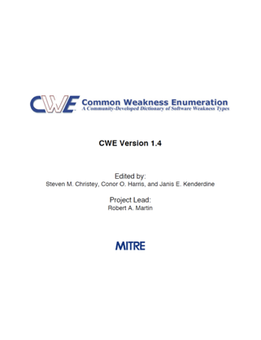
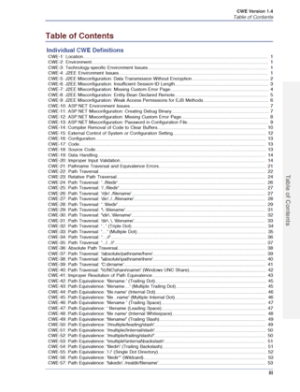
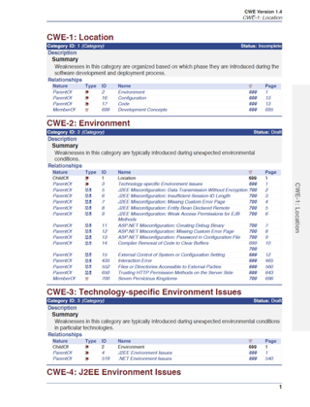
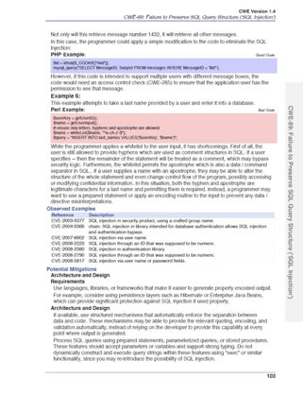
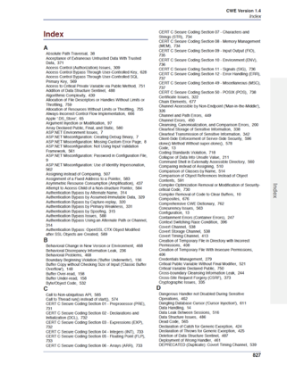
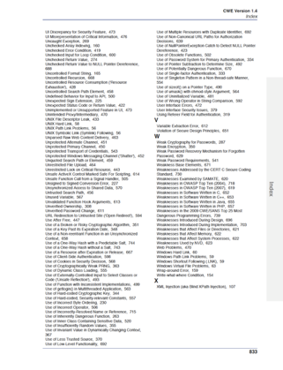
CWE is Meant for People to Use

Slide 28
Common Attack Patter Enumeration and Classification
capec.mitre.org

Slide 29



SQL Injection Attack Execution Flow
User
MS SQL
Database
1. Web Form with ‘ in all fields
2. One SQL error message
SELECT ITEM,PRICE FROM PRODUCT WHERE ITEM_CATEGORY='$user_input' ORDER BY PRICE
3. Web Form with ‘ in ITEM_CATEGORY field
4. SQL error message
5. Web Form with: ' exec master..xp_cmdshell 'dir' --
6. a listing of all directories

Slide 33
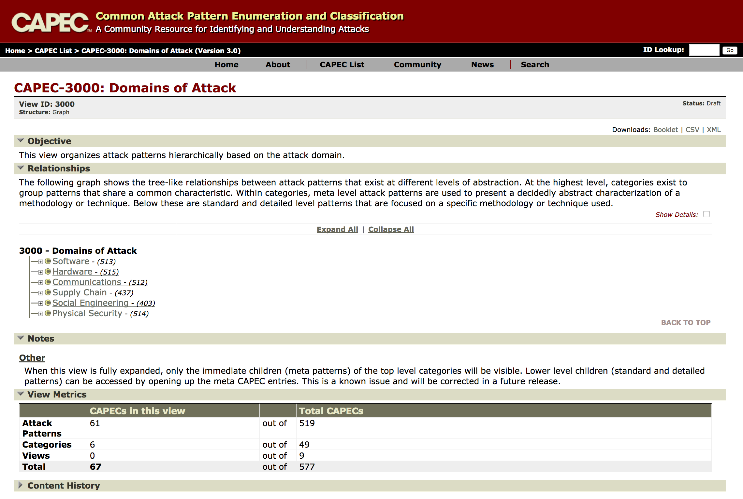

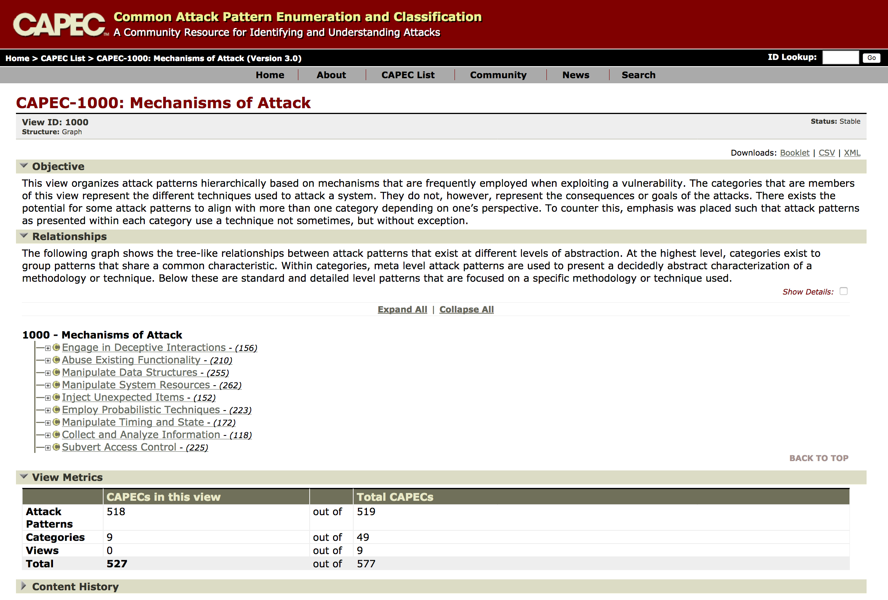
Software, Hardware, Communications, Physical, Social Engineering, and Supply Chain Attack Patterns

Slide 34
Common Weakness Scoring System

Slide 35
For the software we’re responsible for
Notional
CWE
Weaknesses we really care about
How do we identify these?
which weaknesses are most important?

Slide 36
Application Security is about Assuring the Mitigation of Attacks
That Can Impact Operation of Software-Enabled Systems
Known
Threat
Actors
Attack Patterns
(CAPECs)
Weaknesses &
Vulnerabilities
(CWEs/CVEs)
Counter
Measures
- Actions*
Technical
Impacts
Operational Impacts
Attack
Weakness
Item
Impact
Asset
Weakness
Item
Impact
Attack
Function
Attack
Weakness
Impact
System & System Security Engineering
Trades
Asset
Weakness
Item
Modify data
Read data
DoS: unreliable execution
DoS: resource consumption
Execute unauthorized code or commands
Gain privileges / assume identity
Bypass protection mechanism
Hide activities
“Counter Measures - Actions” include:
choices about architecture, design, physical decomposition, and operational approaches;
adding/changing security functions, protection schemes, activities & processes;
use of static & dynamic code assessments;
attack surface analysis, architecture and design reviews; dynamic testing; and pen testing

Slide 37
CWSS & the Common Weakness Risk Analysis Framework (CWRAF) in a Nutshell
CWSS
Scoring Engine
“Vignette”
CWSS Score | CWE
97 | CWE-79
95 | CWE-78
94 | CWE-22
94 | CWE-434
94 | CWE-798
93 | CWE-120
93 | CWE-250
92 | CWE-770
91 | CWE-829
91 | CWE-190
91 | CWE-494
90 | CWE-134
90 | CWE-772
90 | CWE-476
90 | CWE-131
…
CWE
Most Important Weaknesses
User-defined cutoff
W is all possible weaknesses
Wd is all known weaknesses (CWE)

Slide 38
Common Weakness Scoring System (5 Sep 2014)
Base Finding Group
Technical Impact
Acquired Privilege
Acquired Privilege Layer
Internal Control Effectiveness
Finding Confidence
CWSS
Attack Surface Group
ITU-T X.1525
(Mar 2015)
Required Privilege
Required Privilege Layer
Access Vector
Authentication Strength
Level of Interaction
Deployment Scope
Environmental Group
Business Impact
Likelihood of Discovery
Likelihood of Exploit
External Control Effectiveness
Prevalence
Common Weakness Risk Analysis Framework (CWRAF)
Vignettes
Technical Impact Scorecard

Slide 39



Uptake in Standards Bodies...
Spanish
ISO
French
2011 & 2016
2011 & 2014
Russian
Arabic
Chinese
2014
2012
2013
2015

Slide 40
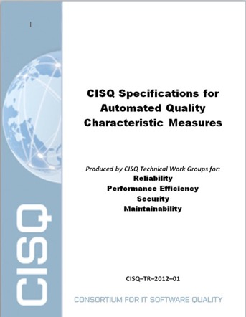
CISQ Software Code Quality Measures
Objective
Develop automated source code measures that predict the vulnerability of source code to external attack. Security measure based on the Top 25 in the Common Weakness Enumeration

Slide 41
Content of CISQ Measures
Example architectural and coding violations composing the CISQ measures
CISQ Quality Characteristic Measures
Security
22 violations
(Top 25 CWEs)
SQL injection
Cross-site scripting
Buffer overflow
Reliability
29 violations
Empty exception block
Unreleased resources
Circular dependency
Performance Efficiency
15 violations
Expensive loop operation
Un-indexed data access
Unreleased memory
Maintainability
20 violations
Excessive coupling
Dead code
Hard-coded literals
Courtesy of Dr. Bill Curtis – Copyright 2018

Slide 42


CISQ/OMG and ISO Software Quality Standards (ISO/IEC 25010)
2012
CWE
OMG Automated Source Code
Reliability Measure (ASCRM)
OMG Automated Source Code Security Measure (ASCSM)
OMG Automated Source Code
Maintainability Measure (ASCMM)
CQE
OMG Automated Source Code Performance Efficiency Measure (ASCPEM)
CWE
CWE
CQE
CQE
2015
2015
2015
2015

Slide 43
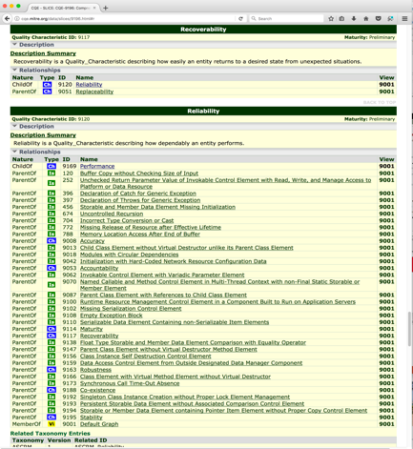
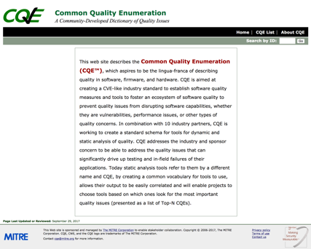
Maintainable
Usable
Portable
Safe
Software Quality
Performant
Secure
Resilient
Reliable
https://cqe.mitre.org

Slide 44
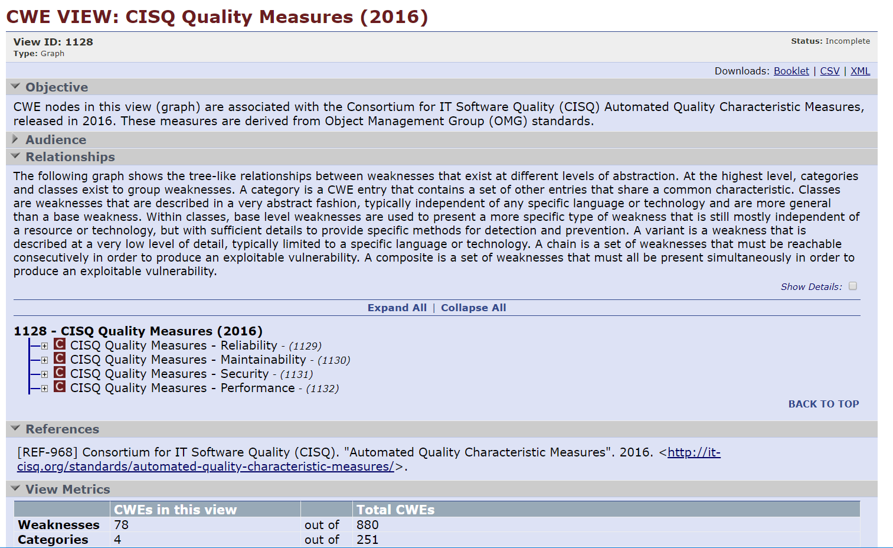
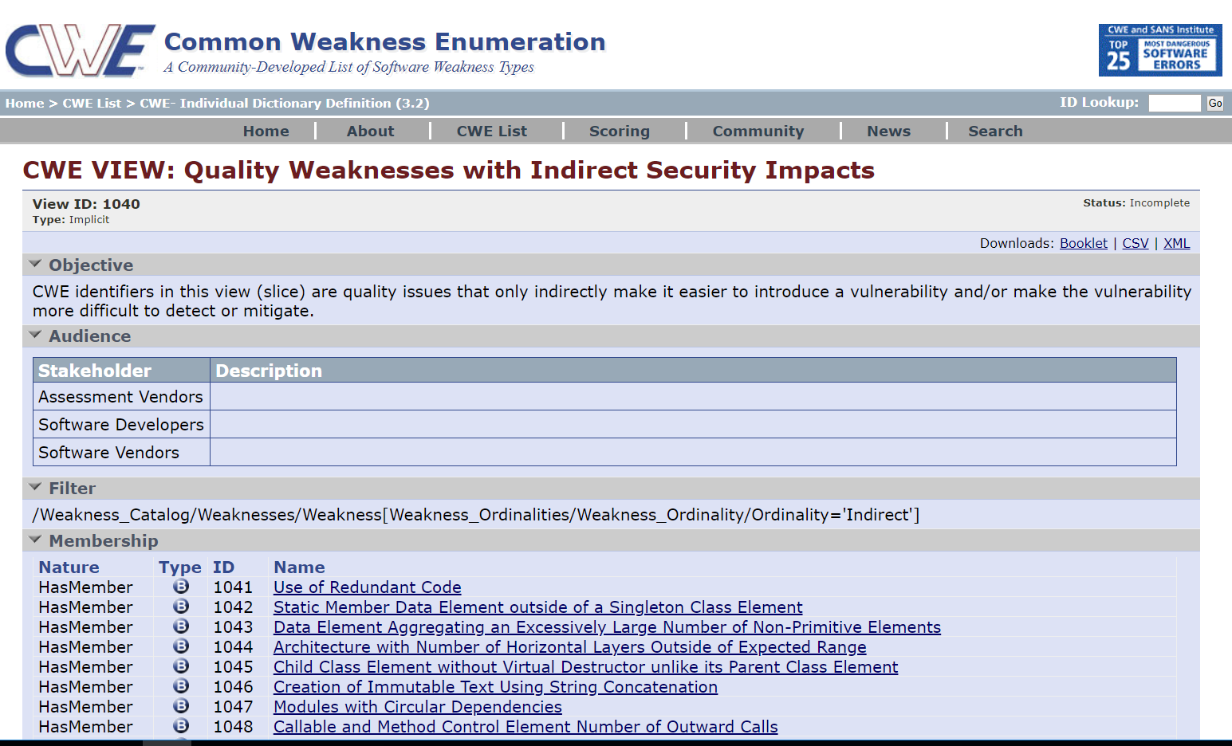
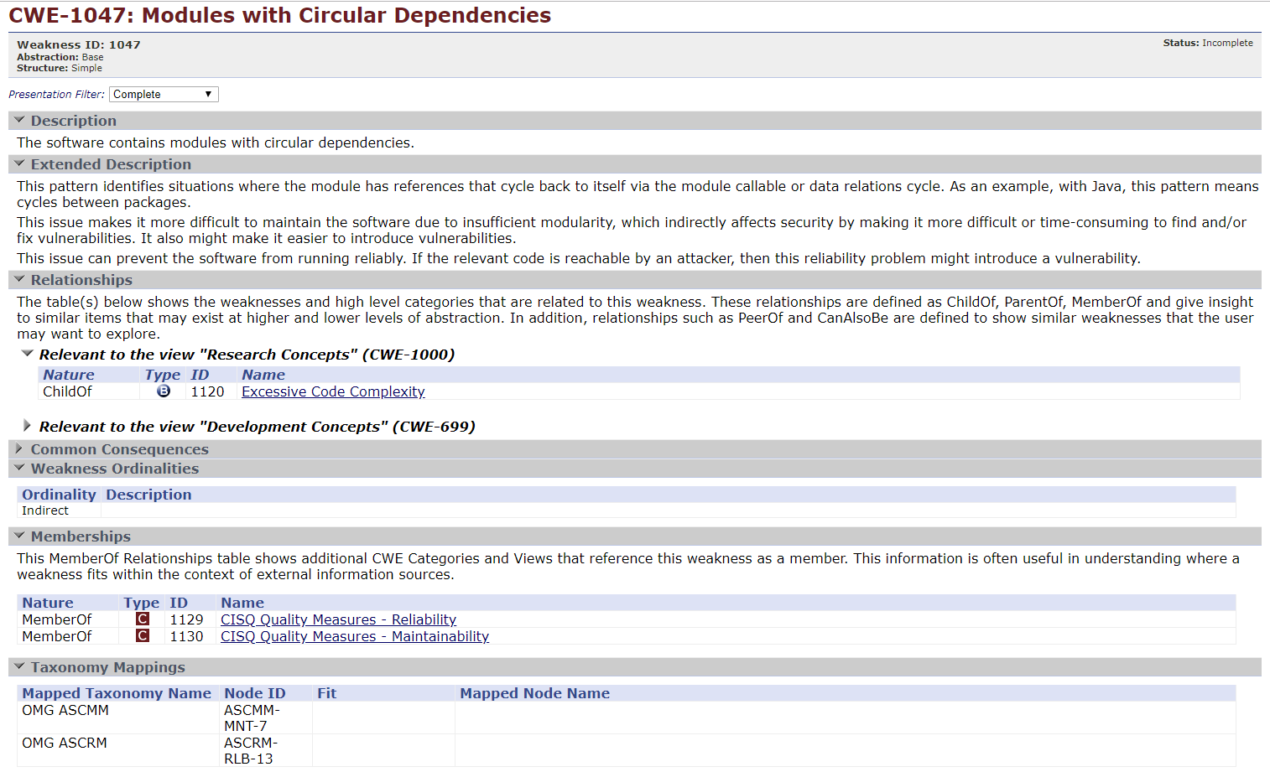
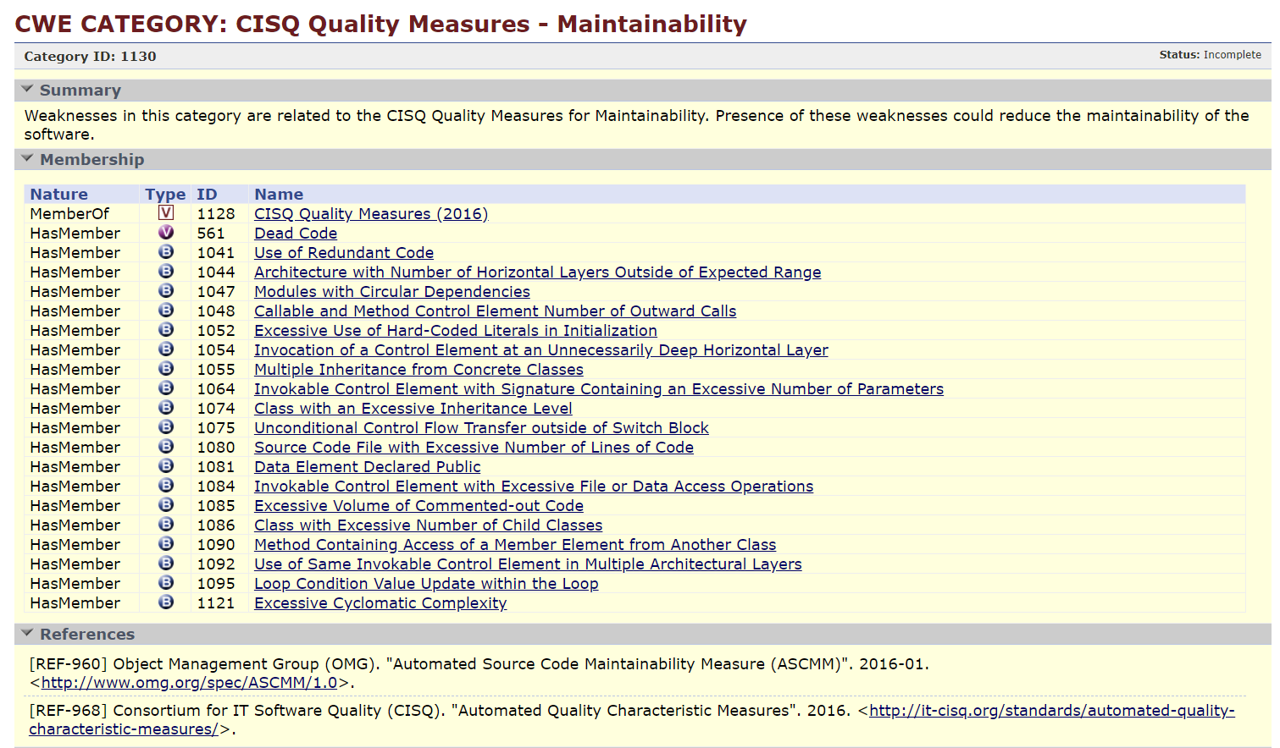
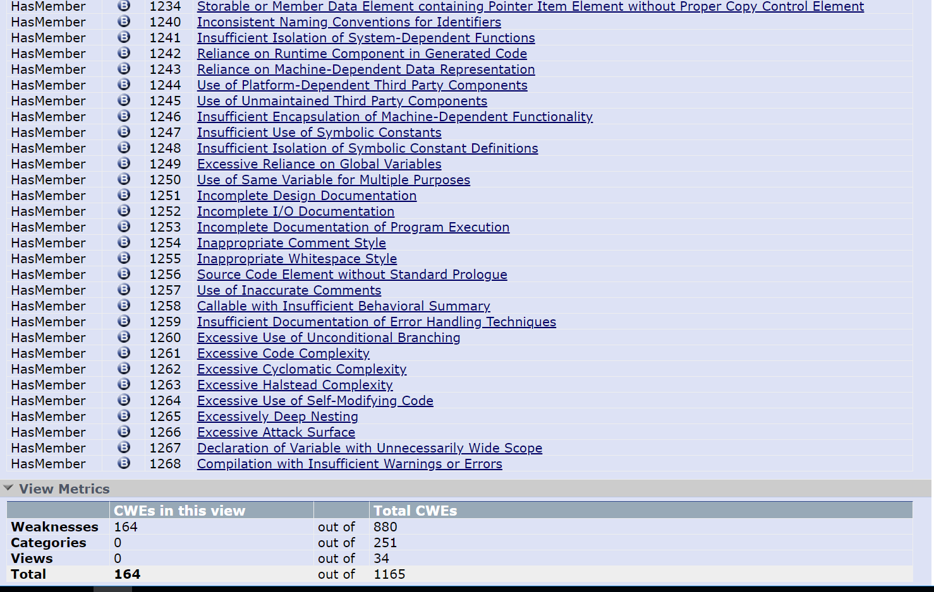
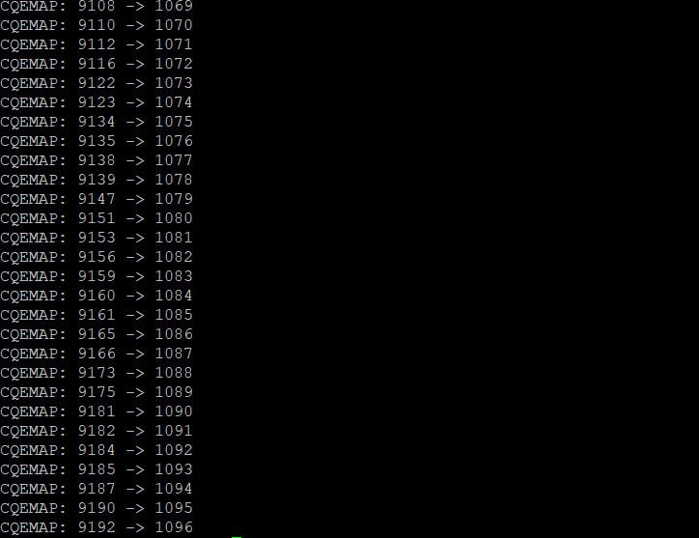
CQE is being integrated into CWE

Slide 45









The Assurance Case
Medical
Space
Aeronautics
Rail
Automotive
Shipping
Autonomous
Critical Infrastructure
Cyber Physical Systems…
Dependability
Engineering
Innovation for Cyber Physical
Systems

Slide 46
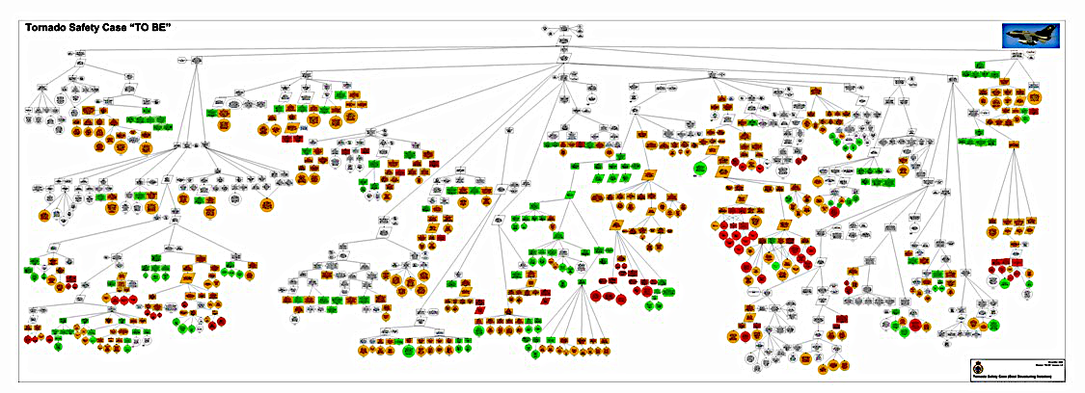
Tornado Operational Safety Case
Apportionment of Ownership:
White = Generic, Green = Air Command, Orange = DE&S, Red = Contractors

Slide 47
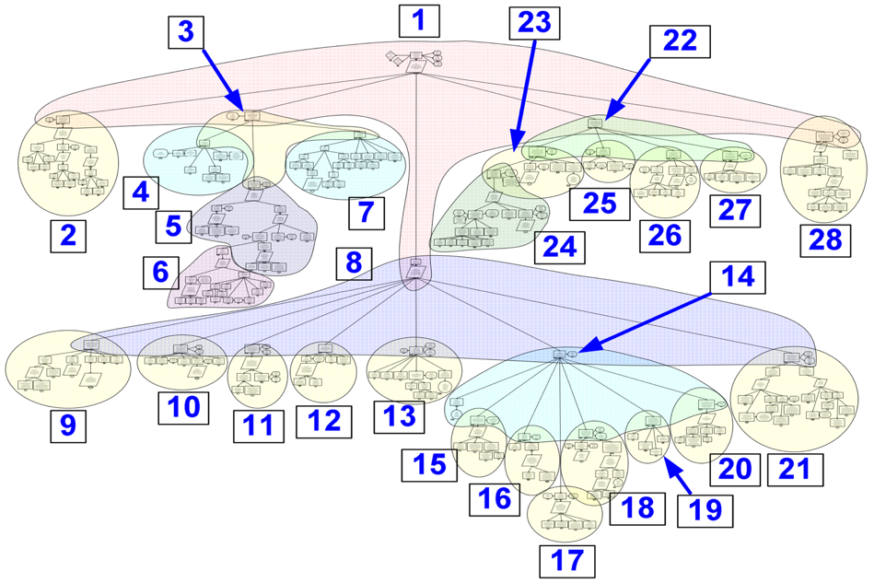
The Assurance Case for a System Builder using Assured Components
Exchange and Composition of Assurance Cases between tools and programs

Slide 48
The Assurance Case for a System Builder using Assured Components
Exchange and Composition of Assurance Cases between tools and programs

Slide 49
Risks to Software-Enabled Connected Microelectronics (SECM)
Connected Software and HW (microelectronics)

Slide 50
Risks to Software-Enabled Connected Microelectronics (SECM)
Applications
Bill of Materials for software and hardware components
SW & HW Part numbers and versions
Libraries & Frameworks Used
Tool Chain Used
Languages and versions
Source Code
Operating System
Libraries & Frameworks
Firmware
Compilers
MicroElectronics
Language Specifications

Slide 51
The Supply Chain for Software-Enabled Capabilities is Complex
Tier 4 Manufacturer/
Supplier
?
?
?
?
?
Customer
Tier 2 Manufacturer/
Supplier
Tier 3 Manufacturer/
Supplier
Tier 4 Manufacturer/
Supplier
?
?
Tier 3 Manufacturer/
Supplier
Contractor
?
Integrating
Manufacturer/
Supplier
Tier 2 Manufacturer/
Supplier
?
US
?
Tier 3 Manufacturer/
Supplier
Global
?
Tier 2 Manufacturer/
Supplier
Tier 2 Manufacturer/
Supplier
Foreign
Pedigree and Providence for software and hardware components
Off-shore
Foreign
Location
Supplier
Software
COTS
US
Foreign
Developers
Bill of Materials for software and hardware components
SW & HW Part numbers and versions
Libraries & Frameworks Used
Tool Chain Used
Languages and versions
Supplier
Acquire
Reuse
Develop
In-house
Outsource
?
?
?
?
?

Slide 52


Cyber Supply Chain Issues: Intentional and Unintentional Acts
Supplier
Intentional acts
counterfeit hardware and software
malicious insertion
Supplier
System Integrator
or Developer
Unintentional acts
poor code quality
vulnerable software inserted unintentionally (libraries, frameworks & COTS or Open Source modules w/CWEs and/or CVEs)
Acquirer
Manufacturer
Result: Systems with adverse behaviors including: Functional degradation/DoS; data exfiltration, espionage, adversarial control.
Supplier
Supplier
Based on SEI/CMU materials

Slide 53

Adversary Attacks are Definable
https://capec.mitre.org
Supply Chain (CAPEC-437)
+ Modification During Manufacture (CAPEC-438)
  + Development Alteration (CAPEC-444)
    -- Malicious Logic Inserted Into Product Software by Authorized Developer (CAPEC-443)
    -- Malicious Logic Insertion into Product Software via Configuration Management Manipulation (CAPEC-445)
    -- Malicious Logic Insertion into Product Software via Inclusion of 3rd Party Component Dependency (CAPEC-446)
    -- Infiltration of Software Development Environment (CAPEC-511)
    -- Hardware Component Substitution During Baselining (CAPEC-516)
    -- Counterfeit Hardware Component Inserted During Product Assembly (CAPEC-520)
    -- Altered Installed BIOS (CAPEC-532)
    -- Infiltration of Hardware Development Environment (CAPEC-537)
    -- Open Source Libraries Altered (CAPEC-538)
    -- ASIC With Malicious Functionality (CAPEC-539)
  + Design Alteration (CAPEC-447)
    -- Documentation Alteration to Circumvent Dial-down (CAPEC-517)
    -- Documentation Alteration to Produce Under-performing Systems (CAPEC-518)
    -- Documentation Alteration to Cause Errors in System Design (CAPEC-519)
    -- Hardware Design Specifications Are Altered (CAPEC-521)
  + Manipulation During Distribution (CAPEC-439)
- Malicious Hardware Component Replacement (CAPEC-522)
- Malicious Software Implanted (CAPEC-523)
- Rogue Integration Procedures (CAPEC-524)

Slide 54
Software is a man-made element that does not follow the laws of physics, chemistry, or other natural orders…
Science of Building
  Motivated by Hammurabi’s Babylonian law code, literally set in stone, of accountability
    4,000 years of learning about the properties of materials
  Constrained by the laws of physics:
    Newton's classical mechanics.
    Einstein's theory of relativity.
    Boyle's law of gases, conservation laws, the four laws of thermodynamics.
Architecting Buildings
  4,000 years of learning to work around the weaknesses in materials
Engineering Buildings
  4,000 years of guild/apprentice → engineering practices and certifications – licensed profession
  science of materials developed and incorporated in building codes, inspection regimes
Science of Software
  ~100 years of mathematics and logic;
  based on little-understood man-made constructs:
  a variety of chip architectures
  a variety of compiler vendors
  a variety of operating system vendors
  slight vagrancies in software specifications allow for different implementations by vendors
Architecting Software
  Driven by economics, time-to-market, cost of creation with no feed-back regarding accountability
Engineering Software
  EULA absolves consequences of failure
  Blind reuse (frameworks, libraries, open source)
  not a licensed profession
  no pervasive understanding of the ”materials science” of software
  need inspection, mitigation, and practical methods for making software appropriately strong

Slide 55
Assurance needs to address the Hazards & Attacks that can impact SW-Based Mission Functions
Known
Threats
& Hazards
Hazard/Attack Activation Patterns
(CAPECs)
Weaknesses
(CWEs)
Counter
Measures
- Actions*
Technical
Impacts to
Mission Capabilities
Mission/Business Impacts
Hazard /Attack
Weakness
Item
Impact
Asset
Weakness
Item
Impact
Hazard
/Attack
Function
Hazard/Attack
Weakness
System & System Security Engineering
Trades
Impact
Asset
Weakness
Item
Most Important Weakness
?
“Counter Measures - Actions” include:
  choices about architecture, design, physical decomposition, and operational approaches;
  adding/changing security/safety functions, protection schemes, activities & processes;
  use of static & dynamic code assessments, dynamic testing, physical testing, and pen testing;
  attack surface & fault-tree analysis, architecture and design reviews

Slide 56



Slide 57
Utilizing Appropriate Detection Methods to Collect Evidence to Gain Assurance…
Artifacts
Detection Methods
Coverage
Design Review
CONOPS
Code Review
Requirements
Attack Surface Analysis
CVE,
CWE,
CAPEC, …
Architecture
Static Analysis Tool A
Design
Process
Static Analysis Tool B
Most Important Quality Issues
Code
Dynamic Analysis Tool C
Binary
Running Binary
Fuzz Testing
Environment of System
Pen Testing
Use of Mission Software
Blue Teaming
Red Teaming

Slide 58

Multiple Sources of Assurance Evidence from Throughout the Lifecycle of the item(s) needing Assurance.
Static Analysis
Malformed Input Testing (Fuzzing)
Dynamic Runtime Analysis
Attack Surface Analysis
Penetration Testing
Red Teaming
Blue Teaming
Architecture Analysis
Design Analysis/Review
CONOPS evaluation
Evidence

Slide 59






Need Standards to Drive Consistency in Discussing and Conveying Assurance due to the Sector-2-Sector linkages
Solar
Electricity Generation
Rejected Energy
Nuclear
Hydro
Wind
Residential
Geothermal
Natural Gas
Commercial
Energy Services
Coal
Industrial
Biomass
Petroleum
Transportation

Slide 60

2015 & 2016 Jeep Hacks:
A failure of assured systems engineering given today’s
connected
world?…
© 2018 The MITRE Corporation. All rights reserved. Approved for Public Release; Distribution Unlimited. Case No: 18-1804-23
Photo: Andy Greenberg/WIRED

Slide 61

(3a) With re-imaged BCM the Radio can send arbitrary CAN Bus Commands (2015)
3a
(1) Took over the Radio (RAD) thru guessable pwd
(3b) (2016) spoofed TPM speed messages…
3b
(2) Reimaged the V850 controller (BCM) Gateway – had a checksum on the images but it wasn’t used

Slide 62


Transparent Assurance As a Basis for Trust - FUTURE
Assurance
Case

Slide 63
IIC Journal of Innovation – September 2018 issue on Trustworthiness
https://www.iiconsortium.org/journal-of-innovation.htm
“Assuring Trustworthiness in an Open Global Market of IIoT Systems via Structured Assurance Cases”
https://www.iiconsortium.org/news/joi-articles/2018-Sept-JoI_Assuring_Trustworthiness-FINAL2.pdf

Slide 64
Questions?

